Slide 1
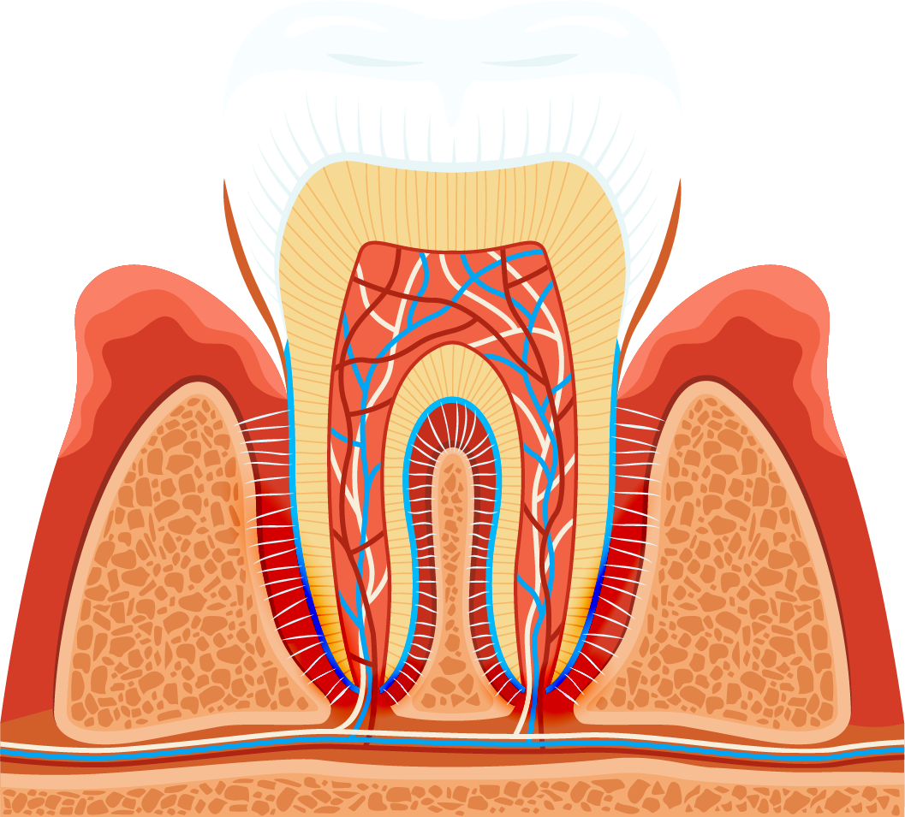
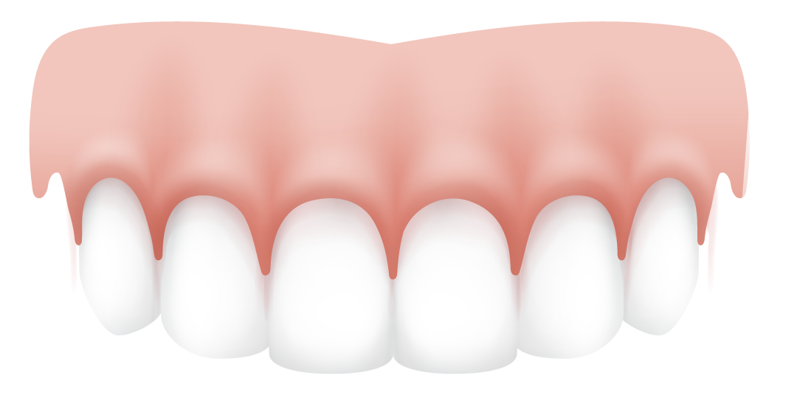
Dentelligence System

Slide 2
Table of contents
01
05
02
06
03
07
Introduction
System Design
Problem Statement
Results
DataSet
future work
Related Work
04

Slide 3
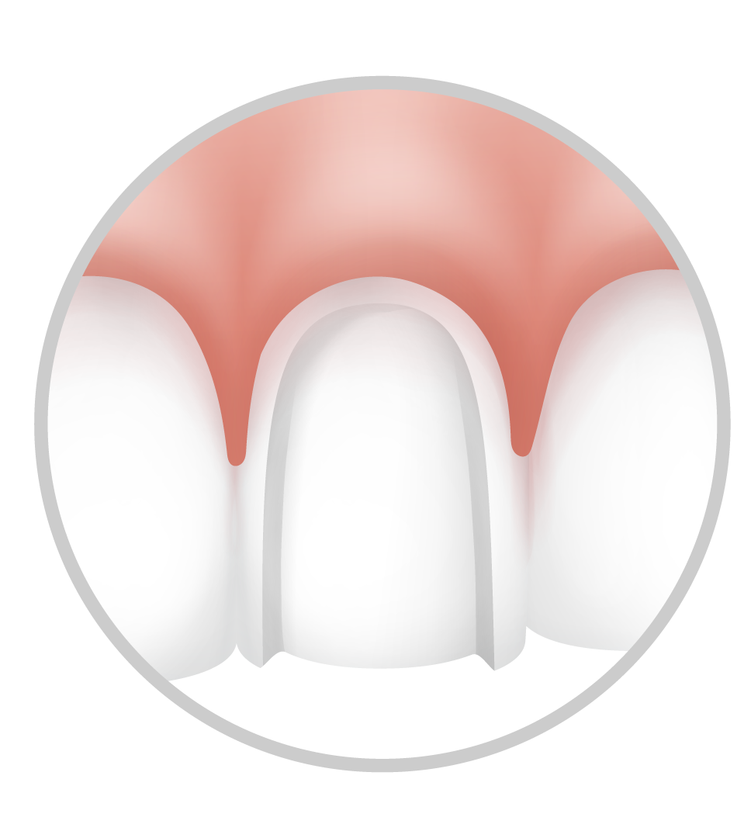
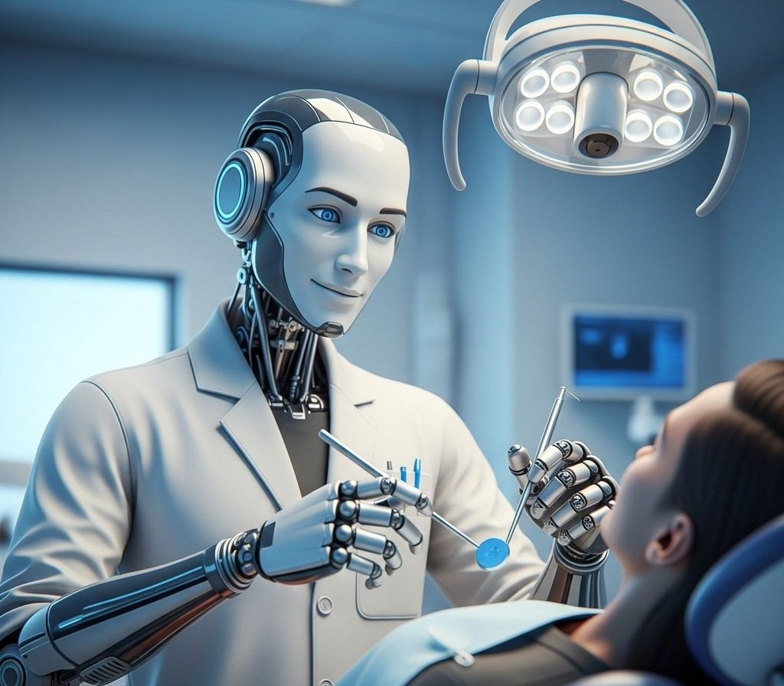
01
Introduction

Slide 4
Introduction
FDI Notation
The Dentelligence System is an advanced AI-powered diagnostic tool designed to analyze panoramic dental X-ray images. As medical imaging becomes increasingly essential in dentistry, clinicians face challenges such as image overload, diagnostic delays, and inconsistency in interpretation. Dentelligence addresses these issues by automating the detection, segmentation, and classification of abnormal teeth using state-of-the-art deep learning models.
The system delivers real-time visual and structured outputs, facilitating faster and more reliable diagnoses. It adopts the Fédération Dentaire Internationale (FDI) notation, ensuring global compatibility in dental reporting and making it suitable for both clinical use and dental education.
Notes:
[1] Tuzoff et al. (2019), [2] Schwendicke et al. (2020), [4] Hamamci et al. (2023), [6] Wang et al. (2025)
Self-supervised learning for medical image classification: a systematic review and implementation guidelines
The utilization of medical imaging technologies has become an essential part of modern medicine, enabling diagnostic decisions and treatment planning. The importance of medical imaging is exemplified by the consistent rate of growth in medical imaging utilization in modern healthcare. However, as the number of medical images relative to the available radiologists continues to become more disproportionate, the workload for radiologists continues to increase. Studies have shown that an average radiologist now needs to interpret one image every 3–4 s to keep up with clinical workloads.

Slide 5
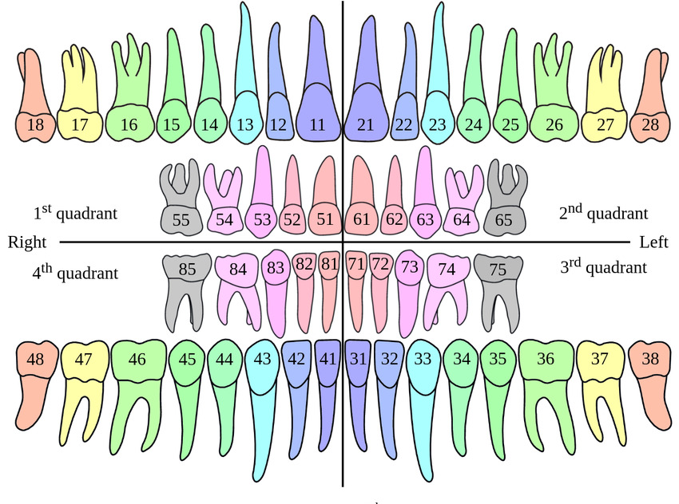
02
FDI Notation:
The FDI notation system is an international standard for numbering teeth using a two-digit code: the first digit represents the quadrant, and the second indicates the tooth's position. For example, “11” is the upper right central incisor, and “36” is the lower left first molar. Dentelligence uses this system to ensure standardized, globally understood tooth identification across clinical and educational settings.
Problem Statement
Notes:
[8] Glick et al. (2012)

Slide 6
02
Problem Statement

Slide 7
Problem Statement
03
While artificial intelligence has made significant progress in medical imaging, most dental AI models focus on narrow tasks—such as detecting cavities or identifying teeth—without offering a complete diagnostic solution. These isolated approaches fail to meet the real-world demands of dentists who need fast, integrated assessments.
Furthermore, the development of robust AI systems is often limited by the need for fully annotated datasets, which are costly and time-consuming to produce. Dentelligence addresses this gap by offering a unified system that detects abnormal teeth, assigns FDI-based IDs, and classifies diseases.
Related Work
Notes:
[3] Sukegawa et al. (2021), [4] Hamamci et al. (2023)

Slide 8
03
Related Work

Slide 9
Related Work
Early research in dental AI primarily focused on individual tasks. For instance, Tuzoff et al. (2019) developed a CNN-based system using Faster R-CNN for tooth detection and VGG-16 for tooth numbering. Their model achieved expert-level accuracy, but it was limited to detection and labeling only. Similarly, Ronneberger et al. (2015) introduced the U-Net architecture, which became a standard for medical image segmentation due to its precise boundary localization—making it ideal for tooth-level segmentation tasks. Helli and Hamamci (2022) further enhanced segmentation using U-Net with morphological post-processing, improving accuracy on small datasets.
Notes:
[1] Tuzoff et al. (2019), [10] Ronneberger et al. (2015), [13] Helli & Hamamci (2022), [4] Hamamci et al. (2023), [6] Wang et al. (2025)

Slide 10
Related Work
04
More recently, the field has moved toward end-to-end AI systems. Hamamci et al. (2023) introduced a diffusion-based hierarchical multi-label model that could handle tooth numbering, quadrant identification, and disease classification simultaneously, even with partially labeled data. Wang et al. (2025) proposed a robust multinational model integrating YOLOv8 for detection and DeepLabv3 for segmentation, achieving near-human performance across eight diagnostic categories. These integrated systems represent a shift toward scalable, real-world dental AI applications like Dentelligence.
DataSet
Notes:
[1] Tuzoff et al. (2019), [10] Ronneberger et al. (2015), [13] Helli & Hamamci (2022), [4] Hamamci et al. (2023), [6] Wang et al. (2025)

Slide 11
04
DataSet

Slide 12
DataSet
05
The DENTEX dataset, introduced during the MICCAI 2023 Grand Challenge, comprises panoramic dental X-rays collected from three different institutions. These images were obtained under standard clinical conditions but with varying equipment and protocols, ensuring diversity in the dataset. The dataset includes hierarchically annotated data:
Partially annotated quadrant data: Images labeled with quadrant information.
Partially annotated quadrant-enumeration data: Images labeled with quadrant and tooth enumeration (FDI numbering).
Fully annotated quadrant-enumeration-diagnosis data: Images labeled with quadrant, tooth enumeration, and diagnosis information for four different dental conditions.
This structured annotation allows for the development and evaluation of AI models across various levels of complexity in dental diagnostics.
System Design
Notes:
2,332 image:
[7] Hamamci, I. E., Er, S., Simsar, E., Yuksel, A. E., Gultekin, S., Ozdemir, S. D., Yang, K., Li, H. B., Pati, S., Stadlinger, B., Mehl, A., Gundogar, M., & Menze, B. (2023). Dental Enumeration and Diagnosis on Panoramic X-rays Challenge (DENTEX). MICCAI 2023 Grand Challenge. Retrieved from https://dentex.grand-challenge.org
Hamamci, I. E., et al. (2023). Diffusion-Based Hierarchical Multi-Label Object Detection to Analyze Panoramic Dental X-rays. arXiv preprint arXiv:2305.19112. https://arxiv.org/abs/2305.19112

Slide 13
05
System Design

Slide 14
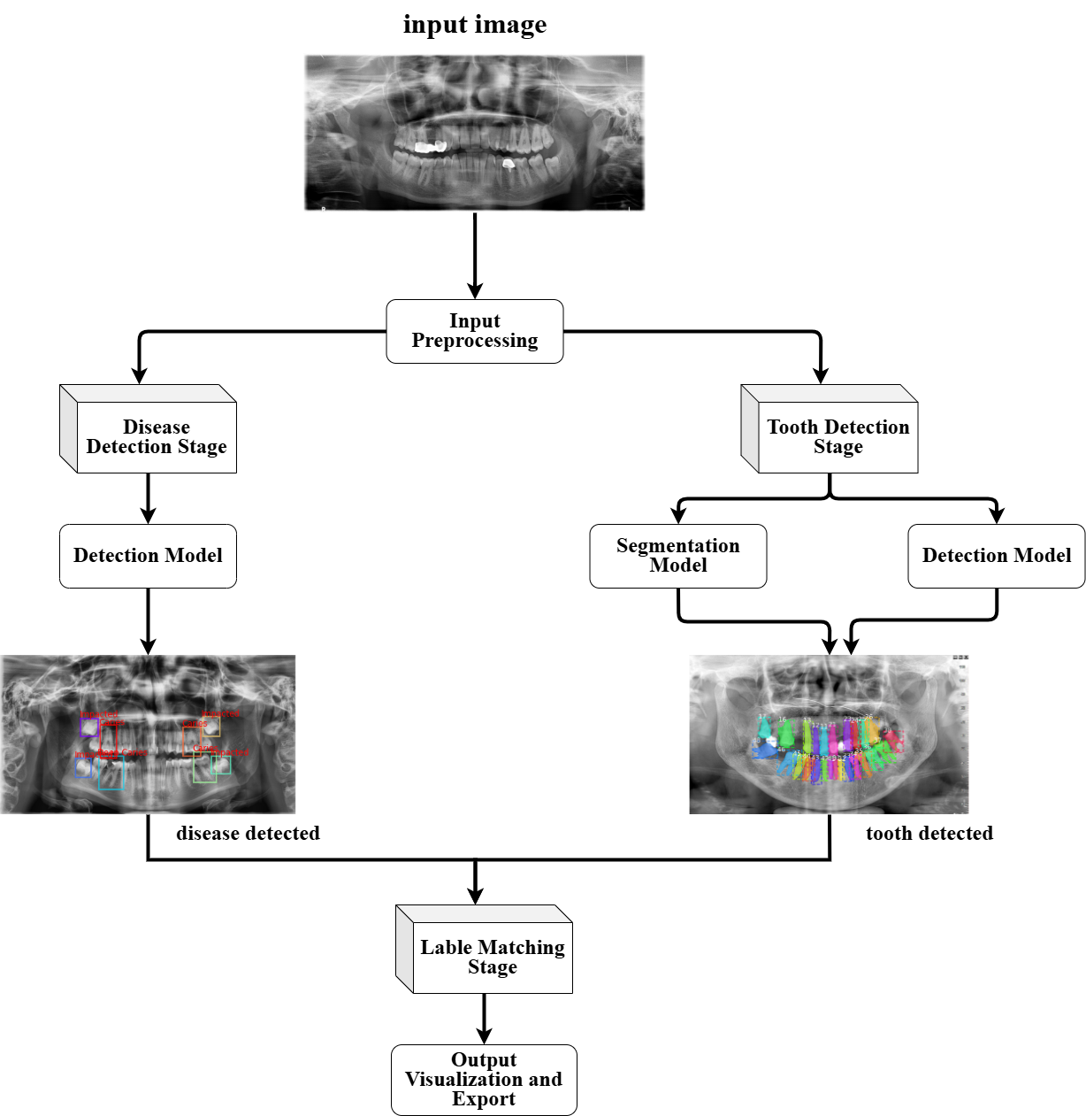
System Design

Slide 15
System Design
• Standardize panoramic X-rays to a consistent resolution
• Normalize pixel intensity values to reduce variability
• Apply data augmentation techniques
• Ensure robust and high-quality inputs for all subsequent models
Notes:
Jullnar radwan

Slide 16
System Design
Notes:
Rama

Slide 17
System Design
Detection plays a central role in establishing spatial context for teeth within panoramic X-rays. By combining DiffusionDet for quadrant identification and DINO-ResNet50 for tooth enumeration, the system provides both coarse and fine-grained localization. These detection models ensure that each tooth is accurately placed and labeled, which is critical for reliable segmentation and disease classification in later stages.
Notes:
Mohammad

Slide 18
System Design
To obtain precise tooth boundaries, U-Net and SE-U-Net are applied. These models generate pixel-level masks, operating both on full panoramic images (enumeration-32) and cropped quadrants (enumeration-9 with an extra “out-of-quadrant” class). The segmentation outputs refine tooth shapes and enhance diagnostic clarity.
Notes:
Rama

Slide 19
System Design
Notes:
Jullnar

Slide 20
System Design
Notes:
jullnar

Slide 21
System Design
Pathological regions such as caries and periapical lesions are detected using an ensemble of DINO-Swin and YOLOv8x. Their predictions are fused using Weighted Boxes Fusion (WBF), which merges overlapping detections and leverages the strengths of both models to improve accuracy and reduce false positives.
Notes:
Jullnar + Rama

Slide 22
System Design
06
Conclusion & future work
Notes:
Mohammad

Slide 23
System Design
In this stage, the system integrates outputs from detection, segmentation, and disease models. Using spatial mapping, confidence voting, and anatomical rules, each tooth is assigned its correct FDI ID, mask, and diagnosis.
The results are presented as annotated panoramic X-rays with labeled teeth and pathologies. They are also exported in structured formats (PNG, JSON, CSV) for easy interpretation, storage, and integration into clinical workflows.
Notes:
Mohammad

Slide 24
System Design
06
Results

Slide 25
06
Results

Slide 26
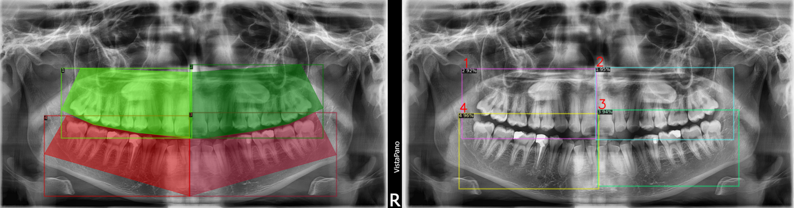
Results
Quadrant Detection Results
• Model used: DiffusionDet with Swin backbone
• Localizes the four quadrants in panoramic X-rays
• Provides accurate crops for downstream enumeration & segmentation
DiffusionDet Ground Truth vs. Predictions
Notes:
Mohammad

Slide 27
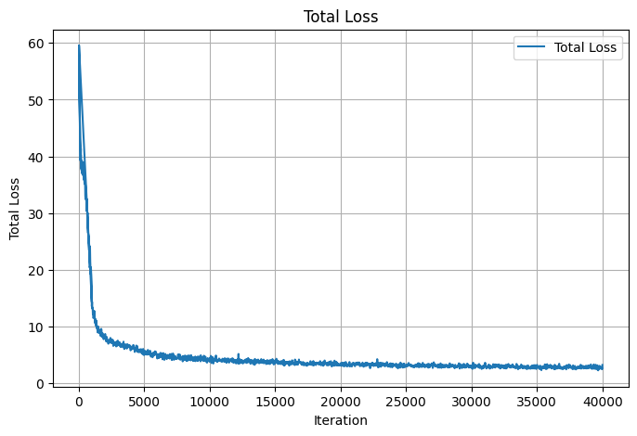
Results
• Quantitative results:
• AP@0.50 = 0.999
• AP@0.75 = 0.892
• AP@[.50:.95] = 0.705
• AR@[.50:0.95] = 0.761
• Conclusion: Reliable quadrant detection ensures high-quality inputs for later stages
DiffusionDet Loss Curve Plot
Notes:
Mohammad

Slide 28
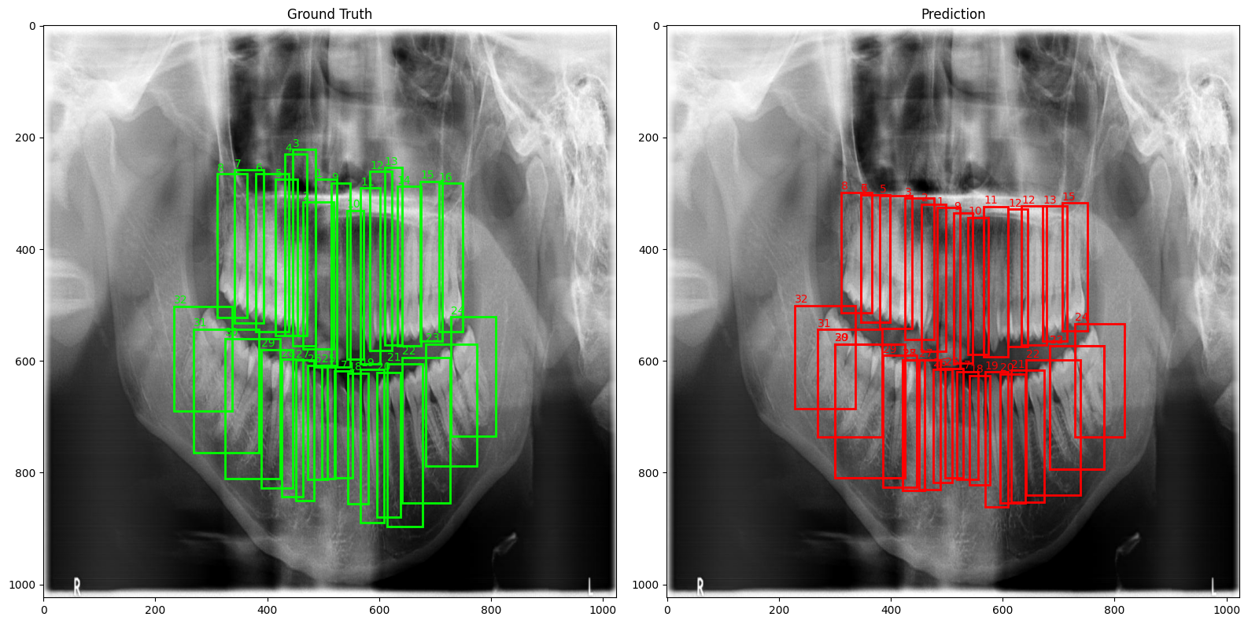
Results
Enumeration-32 Detection Results
• Task: Detect & number 32 teeth in panoramic X-rays
• Model used: DINO with ResNet50 backbone
• Robust detection even in overlapping & low-contrast regions
Dino-ResNet50 Ground Truth vs. Predictions
Notes:
Mohammad

Slide 29
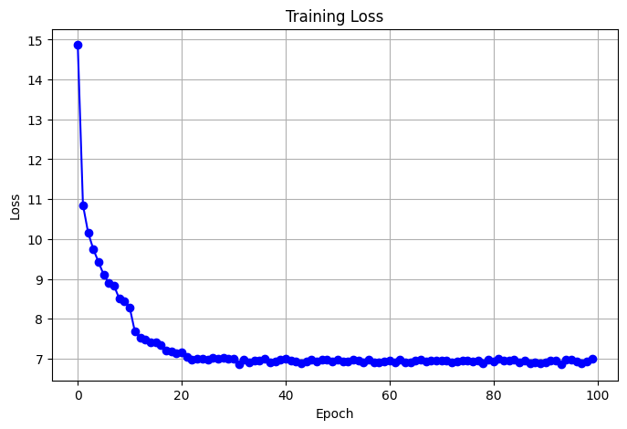
Results
• Quantitative results:
• AP@[.50:.95] = 0.569
• AP@0.50 = 0.959
• AP@0.75 = 0.607
• AR@[.50:.95] = 0.686
• Conclusion: Provides reliable bounding boxes & FDI IDs for all teeth, forming the base for segmentation & diagnosis
Dino-ResNet50 Loss Curve Plot
Notes:
[10] Ronneberger et al. (2015), [13] Helli & Hamamci (2022), [30] YOLOv8 documentation, [34] YOLOv8 architecture figure, [36] Faster R-CNN, [4] Hamamci et al. (2023)

Slide 30
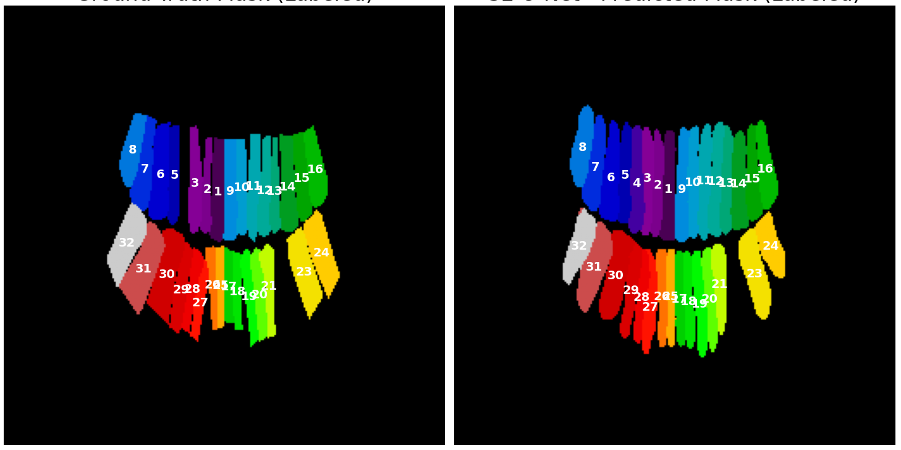
Results
Enumeration-32 Segmentation Results
• Models used: U-Net and SE-U-Net
• Task: Multi-class segmentation of all 32 teeth in panoramic X-rays
• Generates pixel-level masks with clear tooth boundaries
SE-U-Net 32 Ground Truth vs. Prediction
Notes:
Rama

Slide 31
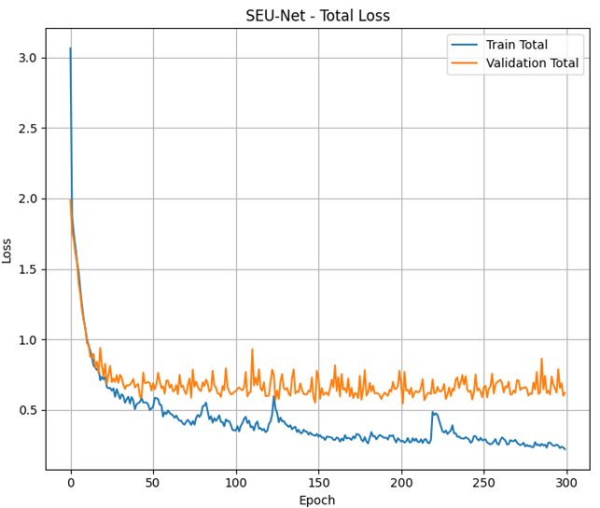
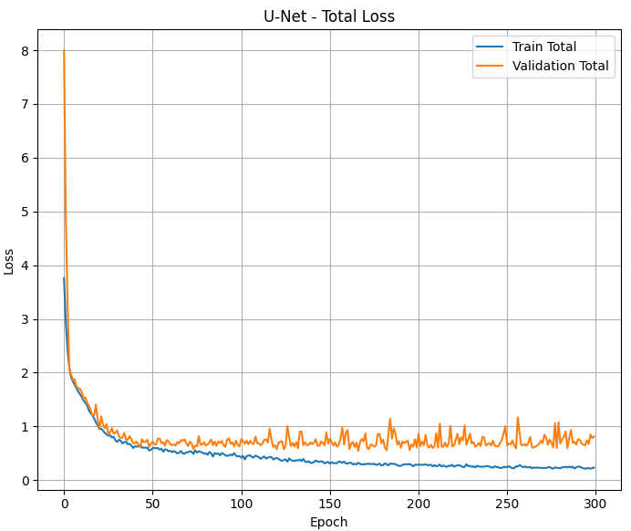
Results
• Quantitative results (best checkpoints):
• U-Net (epoch_166): Dice = 0.7173
• SE-U-Net (last_epoch): Dice = 0.7171
• Conclusion: Both models achieve high-quality segmentation; SE-U-Net offers slightly cleaner boundaries in low-contrast regions
SE-U-net 32 Loss Curve Plot
U-net 32 Loss Curve Plot
Notes:
Rama

Slide 32
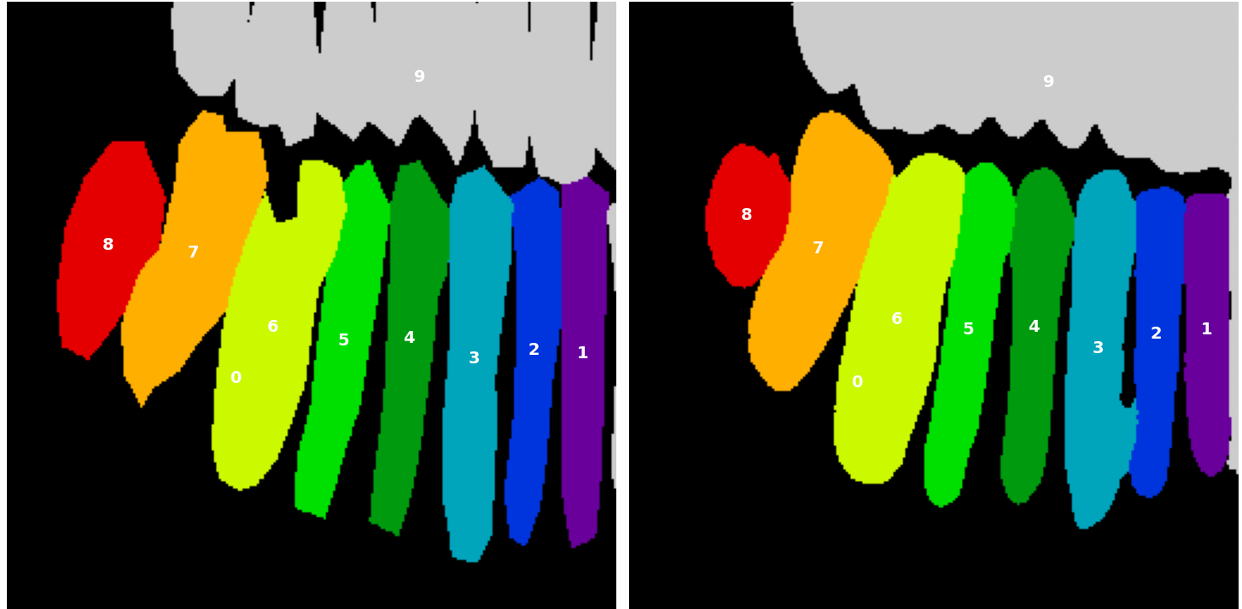
Results
Enumeration-9 Segmentation Results
• Models used: U-Net and SE-U-Net
• Task: Segmentation on quadrant crops (8 teeth per quadrant + “out-of-quadrant” class)
• Focuses on localized analysis with higher precision
SE-U-Net 9 Ground Truth vs. Prediction
Notes:
Rama

Slide 33
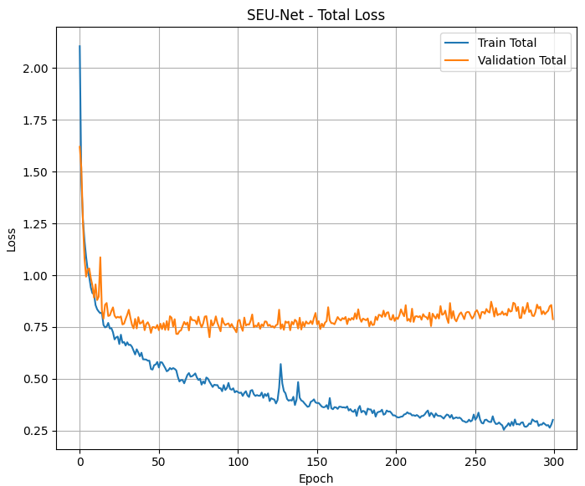
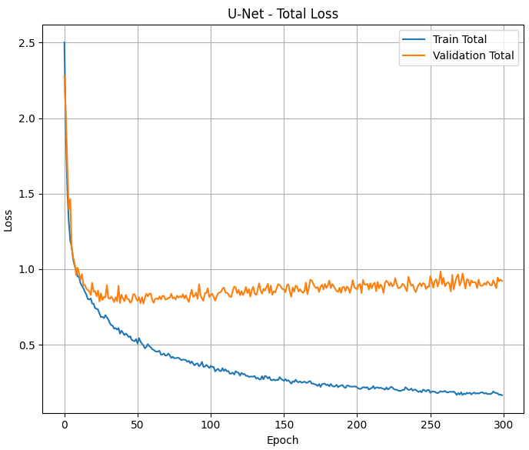
Results
• Quantitative results (best checkpoints):
• U-Net (last_epoch): Dice = 0.7882
• SE-U-Net (last_epoch): Dice = 0.7949
• Conclusion: Both models perform strongly; SE-U-Net consistently provides sharper boundaries and less label bleeding
SE-U-net 9 Loss Curve Plot
U-net 9 Loss Curve Plot
Notes:
Rama

Slide 34
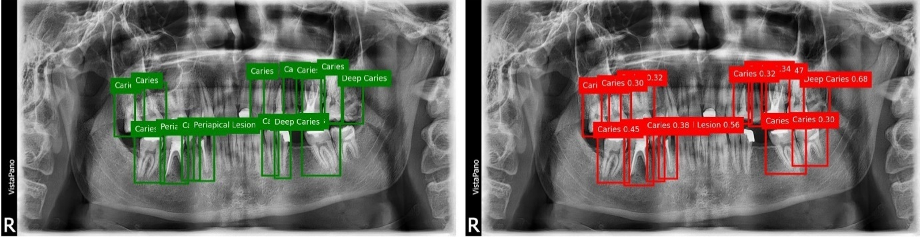
Results
Disease Detection Results
• Models used: DINO with Swin backbone & YOLOv8x
• Task: Detect and classify dental diseases (Caries, Deep Caries, Periapical Lesions, Impacted Teeth)
• DINO-Swin: mAP@[.50:.95] = 0.534
Dino-Swin Ground Truth vs. Predictions
Notes:
Jullanr

Slide 35
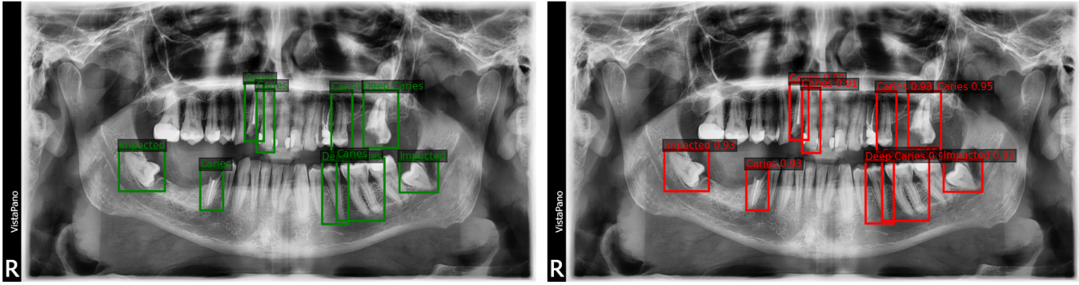
Results
• Models used: DINO with Swin backbone & YOLOv8x
• Task: Detect and classify dental diseases (Caries, Deep Caries, Periapical Lesions, Impacted Teeth)
• DINO-Swin: mAP@[.50:.95] = 0.534
• YOLOv8x: mAP@[.50:.95] = 0.931, Precision = 0.993, Recall = 0.992
YOLOv8 Ground Truth vs. Predictions
Notes:
Jullanr

Slide 36
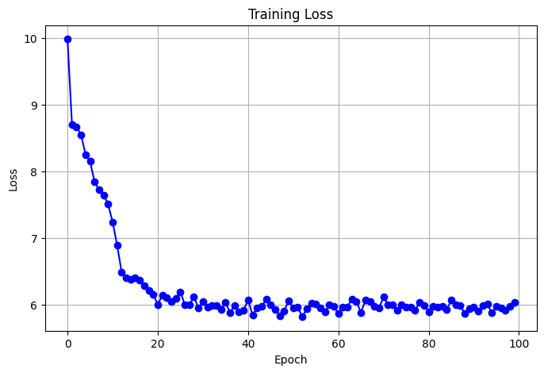
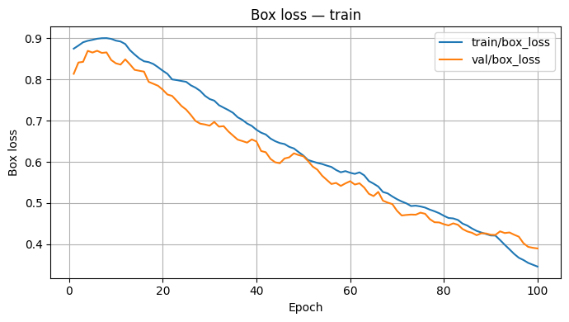
Results
Dino-Swin Loss Curve Plot
YOLOv8 Box Loss Curve Plot
Notes:
Jullnar

Slide 37
Results
07
Ensemble Results with WBF
• Combines outputs of DINO-Swin and YOLOv8x
• Uses confidence-weighted averaging instead of NMS
• Produces more stable detections and reduces duplicates
• Quantitative results:
• mAP@[.50:.95] = 0.823
• mAP@0.50 = 0.964
• mAP@0.75 = 0.945
future work
• Conclusion: WBF leverages YOLOv8x precision + DINO-Swin recall for stronger, more reliable disease detection
NMS/soft-NMS Vs. WBF
Notes:
Rama

Slide 38
07
future work

Slide 39
future work
Thanks
• Pipeline Integration
• Connect quadrant detection, enumeration, segmentation, and disease detection into a unified end-to-end workflow
• Automate data flow across all models to reduce inconsistencies
• Explainable AI (XAI)
• Integrate saliency maps and activation visualizations to improve transparency
• Help clinicians understand why a diagnosis is made
• Dataset & Model Enhancements
• Expand dataset with more diverse cases and additional disease categories
• Explore semi-supervised learning to leverage partially labeled data
• Investigate lightweight/optimized models for faster inference
• Deployment & Clinical Integration
• Develop a GUI for real-time clinical use
• Integrate outputs into EHR/HIS systems for streamlined workflow
• Explore cloud and mobile deployment for tele-dentistry applications

Slide 40
Thanks
Presented by
Mohammad Ismail
Jullnar Radwan
Rama AlHiyari
Supervised by Dr. Wafa Zaal Mohammad Almaaitah
Al-Balqa Applied University Faculty of Artificial Intelligence – Autonomous Systems Department August 2025

